Slide 1
SmartStock: Inventory Optimization for Retail Stores
Presentation by K.Aravinda
Guidance by Shakthi GopalaKrishnan

Slide 2
Table of Contents
Project Overview
Problem Statement
Objectives
System Architecture
Backend Environment
Libraries & Technologies
Backend Architecture
Workflow Diagram
Code Used
Key Features
Results
Applications
Conclusion

Slide 3
Project Overview
SmartStock is an intelligent system designed to automate stock management.
Predicts demand using data analytics and ML models.
Tracks fast-moving & slow-moving items.
Sends real-time low-stock and reorder alerts.
Reduces manual effort and improves retail profitability.

Slide 4
Problem Statement
Frequent stock-out issues causing customer dissatisfaction.
Excess inventory increasing storage cost.
Manual stock counting errors.
No proper forecasting for future demand.
Lack of real-time visibility into stock levels.

Slide 5
Objectives
Maintain optimal inventory levels automatically.
Predict future stock requirements accurately.
Reduce wastage, overstock, and stock shortages.
Improve decision-making with data insights.
Provide real-time stock monitoring and alerts.

Slide 6
System Architecture
Main Components:
User Interface / Dashboard
Backend API
Inventory Database
Data Processing & ML Module
Notification (Reorder) Engine
Reporting & Analytics Module

Slide 7
Backend Environment
Programming Language: Python
Framework: Flask / Django
Database: MySQL
Server: Localhost or Cloud Deployment
Tools: VS Code / PyCharm
Version Control: GitHub

Slide 8
Libraries & Technologies Used
Python Libraries:
  NumPy (computations)
  Pandas (data handling)
  Scikit-Learn (demand forecasting)
  SQLAlchemy (database ORM)
Backend Tools: Flask/Django API
Visualization: Power BI / Matplotlib

Slide 9
Backend Architecture
Layers:
API Layer
  Product data retrieval
  Stock updates
  Forecast API
Business Logic Layer
  Demand prediction
  Reorder level logic
Data Access Layer
  Inventory table
  Sales history table
Scheduler
  Daily forecasting
  Auto-alert triggers

Slide 10
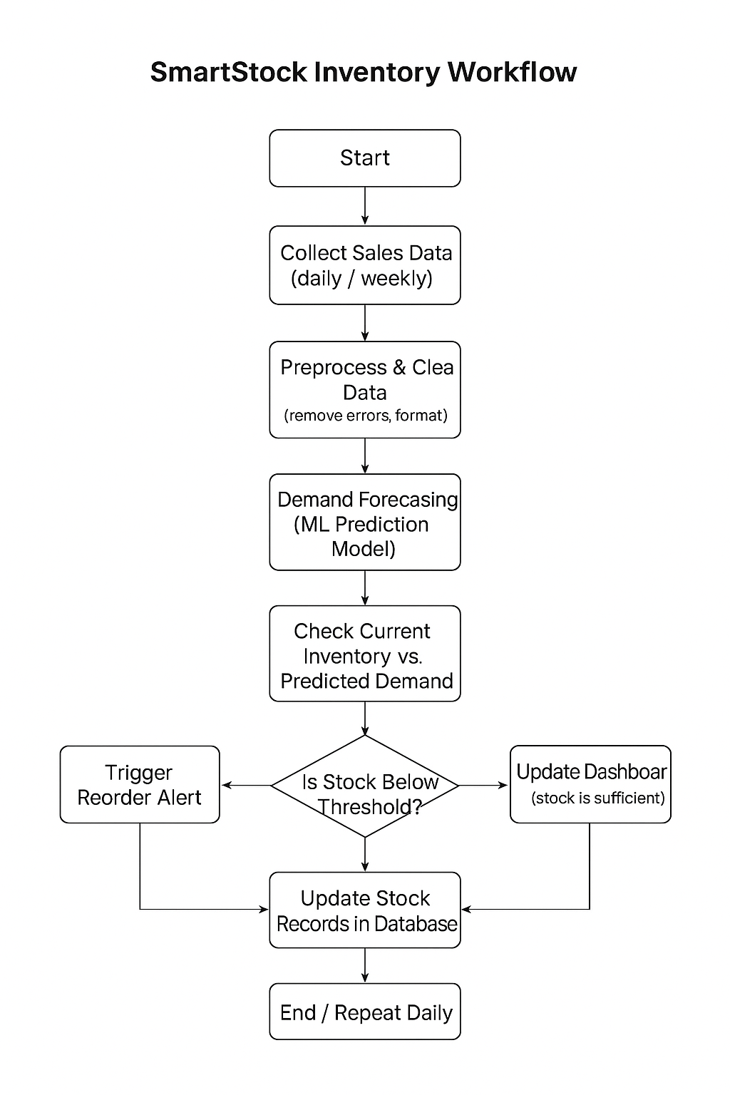
Workflow Diagram

Slide 11
Key Features
Real-time stock monitoring
Automated reorder notifications
Predictive demand analytics
Dashboard with reports
Fast-moving / Slow-moving item detection
Secure database handling

Slide 12
Results
reduced stock shortage occurrences
Lower inventory holding cost
Increased stock turnover efficiency
Accurate forecasting of product demand
Improved operational performance

Slide 13
Applications
Supermarkets
Fashion retail
Electronics stores
Pharmacy stores
E-commerce inventory warehouses

Slide 14
Conclusion
SmartStock enables smarter inventory decisions using automation, analytics, and ML forecasting, ensuring optimal stock levels and improved business efficienc

Slide 15
THANK YOU

